Slide 1
Ethereum & The DAO
Notes:
Welcome everyone to this Workshop on Ethereum & The DAO.
We will have now a quick presentation of Ethereum & the DAO. At the end of this presentation there will be a Q&A.
This means that your questions will be answered at the end of the presentation.

Slide 2
Astratum
Notes:
Before we start the event, I would like to give the stage to Sven that will present you Astratum

Slide 3
Delodi
Notes:
I also would like to thank Thomas & Delodi for their hospitality. This wouldn’t have been possible without them. I give the stage to Thomas to say a few words.

Slide 4
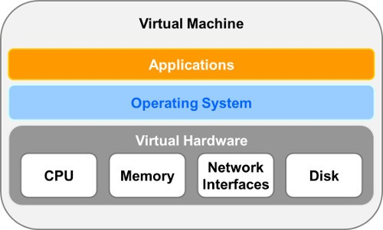
Ethereum The Word Computer
Notes:
So what is Ethereum?
The project wants to be the world computer.
What they mean by that is to build a virtual machine that is unstoppable and works on a network of physical computers.
How do they do that? They have developed a virtual machine where every computation and storage manipulation is written on a blockchain.
Ethereum has three main parts:
The smart contracts. Those are the applications deployed in Ethereum. They are made of code and storage and anyone can communicate with a smart contract through its interface
The Ethereum Virtual Machine: This is the virtual operating system / hardware of the world computer. The Virtual machine takes care of the memory, storage and computation of the world computer
The blockchain. This part makes sure that there is only one state for this world computer throughout the network. Every computation or data storage is written there. This technology has been used because it is the most secure way to have a trestles decentralized world computer.
The blockchain technology is the backbone of Ethereum. Without it, the system wouldn’t be as reliable and secure as it is today.

Slide 5
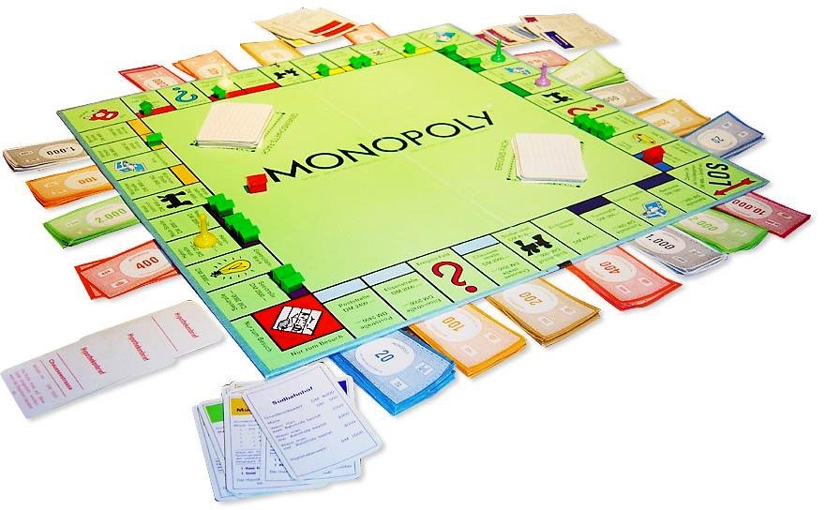
The Monopoly example
Notes:
Let’s take a concrete example.
Let’s imagine 4 people want to play Monopoly together but they don’t live in the same city. So they decide to write a smart contract to play. The smart contract is responsible for:
Handling each player’s balance.
Handling each player’s property registry.
Handling each player’s position on the board.
Handling whose turn it it.
Managing the bank, who should pay taxes and who should get paid by the bank
Application of the rules such as what happens when you are in jail
Enforcing the payments when someone owes something to somebody else. And handling the selling of properties if someones does not have enough money.
So the smart contract’s mission is to ensure that each state of the game follows the rules. In other terms, the smart contract is the translation in code of the game instructions that you can usually find in any board game.
What the smart contract brings us here is:
Unambiguous rules. The rules are embedded in the code and there is no place for interpretation.
Trustless game. Nobody can override the rules.
Or in other words, Ethereum and smart contracts help us define programmatically, human interactions and organizations.

Slide 6
TheDAO
Decentralized
Autonomous
Organization
Notes:
Ethereum and its smart contracts are perfect to define any form of human interaction. This means that it is perfect to code governance schemes or organization.
DAO stands for Decentralized Autonomous Organization.
It is a very generic term to describe any governance structure.
slock.it’s vision was to become the standard framework for any future DAOs. This is why called theirs « The DAO ». The name makes it hard to differentiate between a DAO and « the DAO » from slock.it so as a rule, I will be only talking about The DAO from slock.it, no others.
So what is this DAO and why have people put 14% of all the Ether in circulation into this Smart Contract?
The main idea of the DAO is to be an investment fund on Ethereum to promote projects on Ethereum and improve the Ethereum ecosystem.
The business model is that a project has to show a return on investment scheme to be accepted. For example, The first project slock.it wanted to do was the USN or Universal Sharing Network. The USN is a smart contract that manages the sharing economy. A good use case for that is having an AirBnB like business where people pay through the USN to a home owner and they have automatic access to the home with their phone. In return of funding this project, the DAO would have gotten transaction fees from this Universal Sharing Network.
And what is the lifecycle of the DAO?
In the creation phase, people has sent Ether to the smart contract and receive DAO tokens in return.
After the creation phase, people can propose proposals. The form of this proposal is something like this « I will build this project for the DAO and the DAO token holders will make money with it in this particular way, I need this amount of ETH to do it ».
There are three actors in the DAO:
The token holders - They can vote on proposals
The curator - Their role is to whitelist each proposal to make sure only checked proposals are being voted on.
The proposal makers. They have a project and they want to be paid by the DAO to do it. The modalities are up to each proposal but have to be written in the proposal smart contract.
If you want to get out of the fund, you need to create a split proposal. A split proposal will burn your tokens and move the funds that belong to you to your new child DAO. The amount of Ether that needs to be transferred is the percentage of tokens you have multiplied by the total balance of the DAO. For example if you have 1% of the tokens and the DAO has 100M Eth, you will get 1M ETH.
Several security measures have been put in place here in the DAO to prevent any hijack of the organization.
Proposal whitelists. Each proposal has to be pre approved by the curators. This filters shady proposals
Debate period and waiting period (everything takes time). A proposal has to be debated for at least 2 weeks and at most 8 weeks. This makes it impossible for someone to get its proposal accepted only because not enough people had time to vote on it.
Split wait time lower than proposal wait time. If a proposal come along and you don’t like it, you should be able to split before it comes into action to avoid being stuck with projects you don’t want

Slide 7
The (short) history of The DAO
TheDAO timeline
Notes:
As you can imagine, I wasn’t going to do a presentation about security on Ethereum initially.
But a discussion about security is important to explain what happened, to separate the truth from fiction and help you understand how to avoid this and create amazing projects on Ethereum.
So what happened? How come a project with such heavy security measures has been hacked?
Let’s have a look
[Here I explain the story from the DAO creation until the White hat counter attack. I will take the opportunity to explain a high level explanation of the attack]

Slide 8
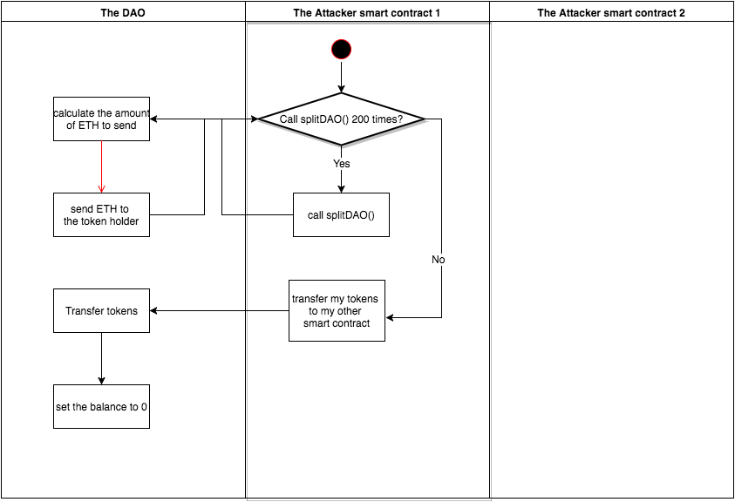
The Attack
Notes:
Here is the high level view of the attack.

Slide 9
DAO Hack summary
This is an attack on an application, not on the network
All the efforts were concentrated on securing against proposal attacks
Split has been missed as an attack vector
The DAO governance model doesn’t let the community react quickly to a bug
There is no way to disable the smart contract in case of an attack
The Ethereum Virtual Machine has an unintuitive execution flow model that lead to the vulnerability.
Notes:
What can we conclude from this attack? What does it mean for future projects on Ethereum?
Ethereum has three layers (smart contracts, virtual machine & Blockchain). This attacks shows no vulnerability on any of these three layers. The attack has been possible because of a bug in the code of the DAO. Saying that Ethereum is not secure because of this event is like saying that the Internet is not secure because a website has been hacked.
A lot of efforts have been put to secure the proposal mechanism.
Unfortunately, the risk of getting hacked through the split function has not been detected. This has not been detected because the risk of calling an external smart contract was not known at the moment of the development.
Because the split function was seen as the « fail safe » mode because people could flee a malfunctioning DAO through it, there was no alternative for people to secure their Ether. The governance model makes it hard on purpose to make any change without a period of time of at least 2 weeks. In our case it was way too long.
As I said, the split function was the fail safe mode. The curators could not disable the DAO in case of an attack such as what happened to the DAO. We are used to have an implicit fail safe to our system. You can always stop the machines, pull the plug. But here, when they say Ethereum world computer is unstoppable, they mean it! So any smart contract needs to explicitly code a way to shut down in case of an emergency.
Finally, Ethereum as a technology is new and it still has unintuitive behaviors. slock.it as well as the community have missed the vulnerability.

Slide 10
Lessons learned
Never assume your code is bug free
Failsafe
Modularize to help fast iterations
Separation of concern to help formal verification
Avoid single point of failure, also in code!
Notes:
So what have we learned from this incident?
First, even after an audit, do not assume your code is bug free. Audits are very important and with time and experience their value will increase but this is not a guarantee of a perfect and bug free code.
This means that you need to incorporate vulnerabilities and unexpected situations in the design of your application. What does it mean concretely? While doing your risk management, you have to understand that there is a risk that your application is not perfect and that someone can attack it in a way you haven’t foreseen.
Your smart contract should be able to be disabled if an attack has been discovered. The governance model needs to let trusted people take care of the smart contract and either dissolve it or update it. Another proposal from Ermin Gün Sirer is to create a Decentralized Hatch for a DAO. (http://hackingdistributed.com/2016/07/11/decentralized-escape-hatches-for-smart-contracts/)
The idea of the Escape Hatch is to have some kind of buffer to be able to revert and react to unforeseen behaviors. The idea here is to have a decentralized Hatch (as opposed to a « naive » one where one person can shut down the entire thing if something goes wrong) where triggers are a mix of programmatic sanity checks and crowd-sourced triggers.
Having simpler smart contracts that interact with one another instead of one complex smart contract that does it all makes it easier to reason about it and check all the possible cases. This helps having more secure code and also code that is easier to update.
Smart contract is immutable, if you want to update it, you need a new version and destroy the old one. It is a good practice to have a Name Service smart contract to handle updates easily. A general naming smart contract is currently under development by the foundation.
Single point of failure is bad! For smart contract, there is always a way to decentralize and mitigate the amplitude of a risk. Avoiding centralization is core to blockchain technology. We cherish consensus and risk decentralization. But remember! This is also true for smart contract. You have to avoid having one smart contract that can bring down your entire project.

Slide 11
Security
The most secure system are anti-fragile
Only those who fail and raise stronger last
Developer tools are on the way
Notes:
It is still too early to know the full extend of the impact the incident will have to Ethereum. But it has taught us a lot about how to address the security aspect of a project on Ethereum and also how secure the protocol and infrastructure really is.
The failure of the soft fork is a good sign. It shows that even the creators of Ethereum cannot easily alter the protocol without the need to create an entirely new network (Hard fork) and it also shows that any attempt to censor the network will lead to a Denial of Service vulnerability.
We have re-centered the debate around security by being reminded, the hard way, that even the best engineers make mistakes and write bugs. Ethereum has been very careful in its development process and they have not only audited its code with security specialists but the entire community has tested it to see if they can attack it or not. If someone had a way to steal if just only a part of the +1B$ valuation, they would do it.
The best way to have a system that is resilient to attacks is a system that is constantly attacked. The DAO project has made mistake and we pay for it. The good part of this is that every other project on Ethereum will benefit from what happened. We will learn from it and get new tools to ensure the security of our projects.
Lately, I had a very interesting discussion with Dr. Christian Reitwießner who told me about a project he has been working on for the last 8 months. It is called « Solidity why3 » and it is a formal verifier for Solidity code. It means that it analyses the code for common bugs and detects potential vulnerabilities in the code. These kind of projects will become more important after what happened and the community will bring tools to make your Smart Contracts better.
Best practices come from experience. The community is building best practices for future projects. It helps building solutions that evolves faster, are easier to protect and avoid human errors. The solidity documentation is a good place to start for that but I suggest to look at the multiple initiatives to compile best practices to write smart contracts in Ethereum.
This incident shows a community that is focused on solving problems and moving forward. Time will tell if their strategy pays off but the level of pragmatism is amazing and very encouraging for the future.

Slide 12
Q&A
Notes:
[Discussion about the presentation, questions being answered etc …]

Slide 13
BREAK

Slide 14
DAO Workshop
Notes:
The rest of the workshop will go as follow:
We will make sure that everybody has an account ready on testnet with some ETH
Then each of you will get tokens from our own DAO
After that, it is time to do some code. I propose we all use Ethereum Studio because it is a fully web based environment that doesn’t need any installation.
For those of you who don’t know how to code or prefer to listen rather than coding, I will be doing my proposal live.
After my proposal is done, I will help you as much as I can to write your own if you get stuck.
During the workshop, people on the slack are here to help. So feel free to ask there anything.
at 9pm, the DAO creation phase will end, it will be time for every token holder to vote for the proposals. There will be mine but maybe others too. It is time for everyone to participate and be part of a decentralized organization
Time for a wrap up, discussions and some more coding

Slide 15
Ethereum Mist setup
Notes:
Show how to create a new account
Show how to get some Test ETH

Slide 16
Join the DAO
Notes:
Show the address of the DAO
Show how to send 1 ETH to the DAO
Show how to add a contract watch to the DAO
Show how to see the tokens you have in the DAO

Slide 17
Prepare your proposal
Notes:
It is time to write your proposal.
You can either do it yourself or follow mine.
If you want to actually code something, go to live.ether.camp and sign in with your user account (or sign up if you don’t have an account)
When you are signed in, you will have a button « Ethereum Studio Start Now ». Click here and open it.
There clone the repository I’ve prepared for the workshop and edit the offer_complete.sol file

Slide 18
DAO Proposal steps
What do you actually propose?
Who are the actors of the proposal?
Who can do what?
How much money do you need to set up the project? How much money do you need each day?
If you have a reward scheme, how is it calculated?
Notes:
Like any coding session, you need to define first what you are going to do before you can actually do it.
In my example, I am going to make a proposal for a decentralized application, or DApp, to handle the DAO. (Usually, you need to provide a document and publish it on IPFS, we won’t do that here)
Then who is going to work on this project?
One project manager, he is in charge of setting up the proposal, the salaries and selecting the team
Frontend developer. He is in charge of actually building the application, integrating it with the DAO Smart contract. It is a standard DApp, i.e. it is a single page application that is supposed to be running on the Ethereum Mist Browser
A designer, to make everything beautiful, we will need a top notch designer for the application.
How will everyone be paid?
40% go to the developer
40% go to the designer
20% go to the project manager
Let’s say the project will take 10 days. For the sake of the workshop, we need 1 ETH per day for 10 days which makes a total cost of 10 ETH.
Ok so let’s code now !

Slide 19
Improvements ?
Notes:
If we have time, we can have a look at the dApp proposal and improve it together.
Any suggestions?
My suggestion is to improve how we update the rates. Right now the projectMgr is the only one who can change them, it should be democratic no?

Slide 20
It is voting time!
Notes:
I am publishing my proposal and people can select whether they accept it or not (Please accept it, pretty please :) )
If someone wants to publish his we can do it too

Slide 21
Time to work!
Notes:
Hopefully people were nice and voted Yes to my proposal (otherwise I will find a way) and I show how I can get my ETH from the proposal.

Slide 22
Thank You !
Notes:
People can either go or continue to discuss and play with the code

